Slide 1
TNSDC-
Generative AI project
Submitted by
J.JAYA AISHWARYAA
3/21/2024 Annual Review

Slide 2
Project Title:
Sentimental Analysis on Twitter dataset using Convolutional Neural Networks(CNN)

Slide 3
AGENDA
Problem Statement
Project Overview
End Users
Solution and Value Proposition
Unique Things about Solution
The WOW in solution
Modelling
Results

Slide 4

PROBLEM STATEMENT
With the exponential growth of social media platforms like Twitter, there's an abundance of user-generated content in the form of tweets.
Analyzing the sentiment expressed in these tweets manually is time-consuming and impractical, especially given the sheer volume of data.
Therefore, there is a need for an automated sentiment analysis solution that can classify tweets into positive, negative, or neutral sentiments accurately and efficiently.

Slide 5

PROJECT OVERVIEW:
The project involves developing a sentiment analysis model based on Convolutional Neural Networks (CNN) architecture.
CNNs have shown promising results in natural language processing tasks, including text classification, due to their ability to capture spatial patterns in sequential data like text.
The model will be trained on a large dataset of labeled tweets to learn patterns associated with different sentiment categories. Once trained, the model will be capable of classifying the sentiment of unseen tweets accurately.

Slide 6
WHO ARE THE END USERS?
Social Media Analysts: Professionals analyzing social media trends and public opinion will benefit from the automated sentiment analysis tool to gain insights into user sentiment and behavior.
Marketing Professionals: Marketers can utilize the sentiment analysis system to gauge customer feedback, sentiment towards their products or campaigns, and tailor marketing strategies accordingly.
Customer Service Teams: Customer service teams can monitor sentiment on social media platforms in real-time and promptly address customer concerns or complaints, enhancing customer satisfaction.
Researchers: Researchers studying public sentiment, social trends, or sentiment-driven phenomena can use the sentiment analysis tool to analyze large volumes of social media data efficiently.

Slide 7

YOUR SOLUTION AND ITS VALUE PROPOSITION
The proposed solution offers the following key features and value propositions:
Automated Sentiment Analysis: The system automates the process of sentiment analysis, enabling efficient analysis of large volumes of tweets in real-time.
Accuracy and Efficiency: Leveraging CNNs, the model achieves high accuracy in sentiment classification while being computationally efficient, allowing for rapid analysis of tweets.
Real-time Insights: The system provides real-time insights into user sentiment, enabling timely responses and informed decision-making.
Scalability: The solution is scalable and can handle large datasets and high volumes of incoming tweets, making it suitable for applications in various domains.

Slide 8

THE WOW IN YOUR SOLUTION
CNN Architecture: Leveraging CNNs for sentiment analysis of text data is a unique aspect of the solution. CNNs excel at capturing spatial patterns in sequential data, making them well-suited for text classification tasks.
Transfer Learning: The model may utilize transfer learning techniques, such as pre-trained word embeddings, to leverage knowledge learned from large text corpora, enhancing performance, and generalization.
Fine-grained Sentiment Analysis: The solution may incorporate fine-grained sentiment analysis, categorizing tweets into multiple sentiment categories (e.g., strongly positive, mildly positive, neutral, mildly negative, strongly negative) for more nuanced insights.
3/21/2024 Annual Review
‹#›

Slide 9
MODELLING
Model Architecture: Design the CNN architecture for sentiment analysis. This includes defining the layers of the CNN, such as convolutional layers, pooling layers, and fully connected layers.
Training: Train the CNN model using the preprocessed and feature-extracted data. During training, the model learns to classify tweets into different sentiment categories (positive, negative, neutral).
Evaluation: Evaluate the trained model's performance using metrics like accuracy, precision, recall, and F1-score on a validation dataset.
Fine-tuning and Optimization: Fine-tune the model hyper-parameters and architecture to improve performance. This may involve techniques like adjusting learning rate, batch size, or adding regularization.
Data Preprocessing: This involves cleaning and preprocessing the tweet data, including tokenization, removing stopwords, handling emojis, etc. Feature 6.Extraction: Convert the preprocessed text data into numerical representations that can be fed into the neural network. This typically involves techniques like word embedding.
‹#›

Slide 10
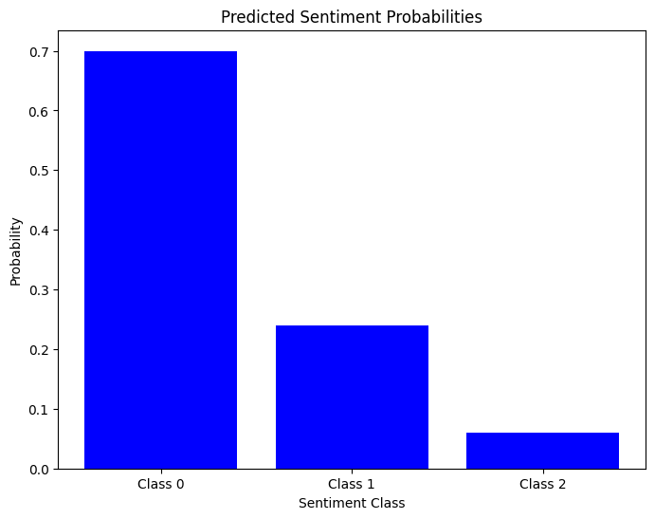
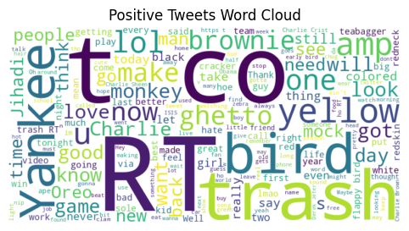
RESULTS
‹#›

Slide 11
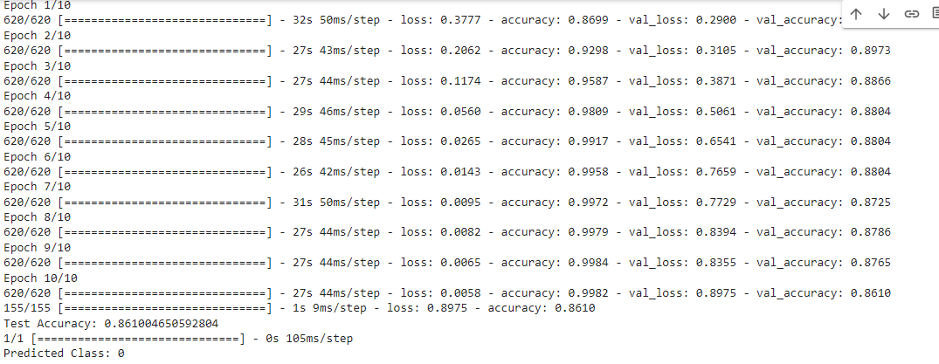
Result-Prediction
Github link:https://github.com/Jayaaishwaryaa/TNSDC-Generative-AI.git

